Slide 1
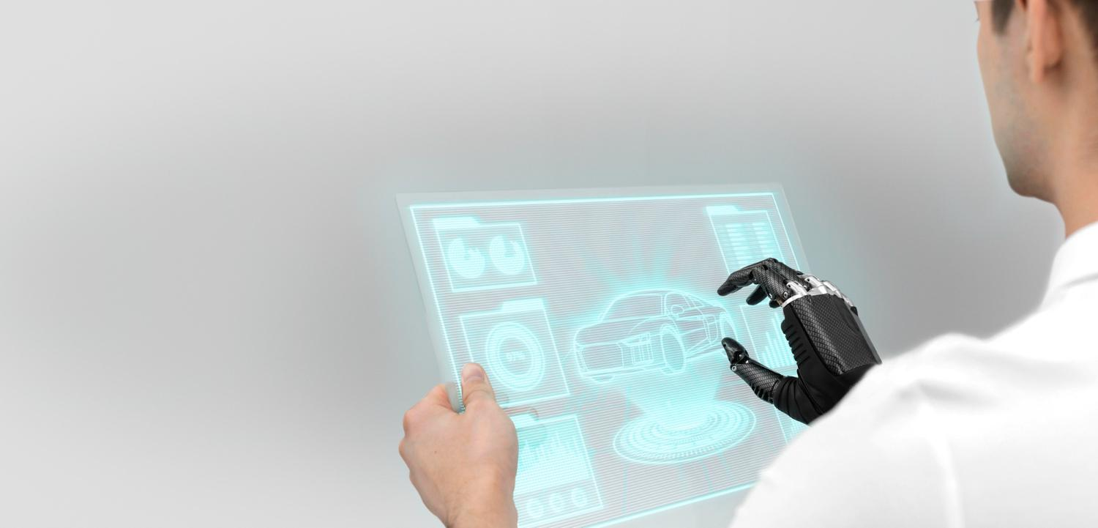
Zero Carbon Emission Engine
Let’s Explore The Magic Of Science And Engineering.
Aquib Jawaid Ansari
DME 6th Semester (NCP)

Slide 2
Table of contents
01
Why Not Traditional Engines?
02
Why Not EV?
03
The Fuel..!!
04
How The Engine Works?
We will discuss the reasons why we can’t consider Traditional Engines for long term.
We will discuss why EV can’t be considered as eco friendly engines.
The most important stuff which is required for an engine to work.
The science behind the zero carbon emission engines.

Slide 3
Table of contents
05
Hydrogen! A BOMB!
06
WATER ENGINE!
07
Why Engineers Are Not Working On These Engines?
08
Disadvantages
We will see how we are overcoming this problem.
This is the idea which is known to be fake, as many low class/illiterate engineers on youtube are using logicless process just for views. But, I will prove the concept how it can be possible with the help of Science & Engineering.
ARE THEY STUPID? No, we will see how.
Every man made technology do have a negative side, we will see what are the disadvantages in these Engines.

Slide 4

01
Why Not Traditional Engines?
We will discuss the reasons why we can’t consider Traditional Engines for long term.

Slide 5
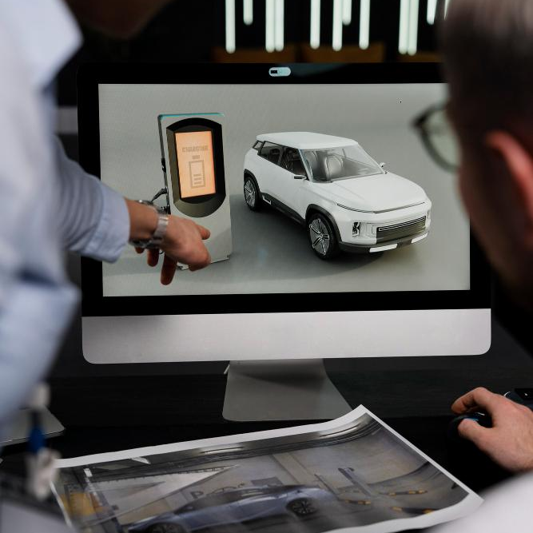
Traditional engines are based on fossil fuels.
We have limited fossil fuels.
Burning of fossil fuels = Carbon Emission.
Carbon Emission = Pollution
Pollution = Delhi
Delhi = capital of India as well as pollution.

Slide 6
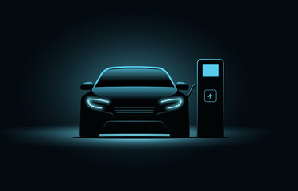
02
Why Not EV?
We will discuss why EV can’t be considered as eco friendly engines.

Slide 7
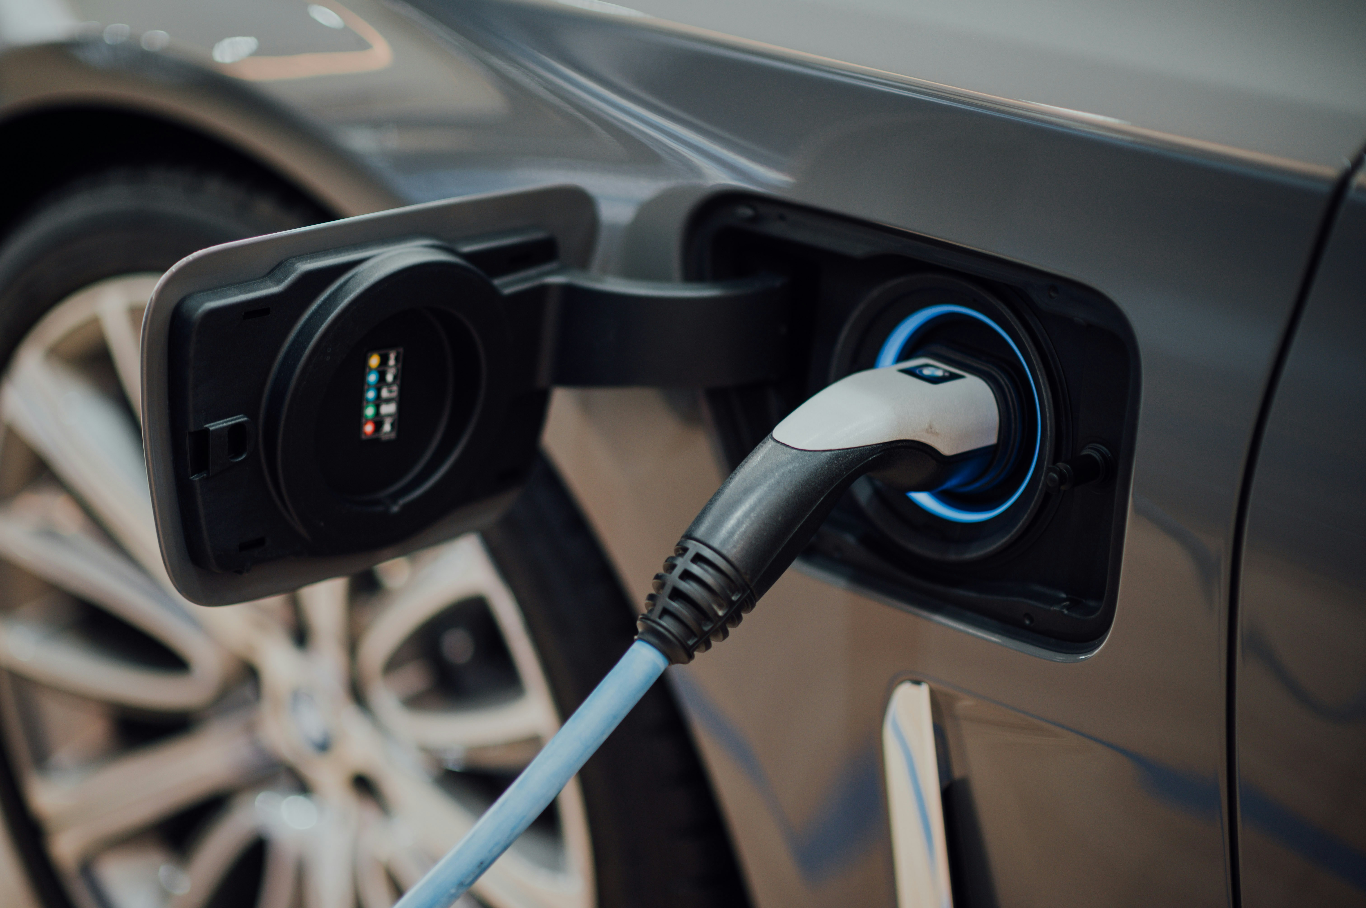
1. EV Aren’t Eco Friendly.
While they are considered as eco friendly cars, but although they don’t emit carbon while in operation but in order to charge them we have already used fossil fuels. Then overall how can it be zero carbon emitting engine?
2. Batteries.
They are needed to be replaced every 3rd to 4th year.

Slide 8

Battery production contributes to pollution through raw material extraction, energy-intensive manufacturing processes, waste generation, and supply chain emissions.

Slide 9
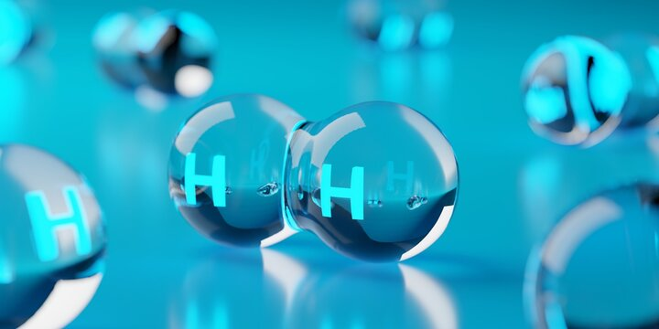
03
The Fuel..!! [Hydrogen]
The most important stuff which is required for an engine to work.

Slide 10
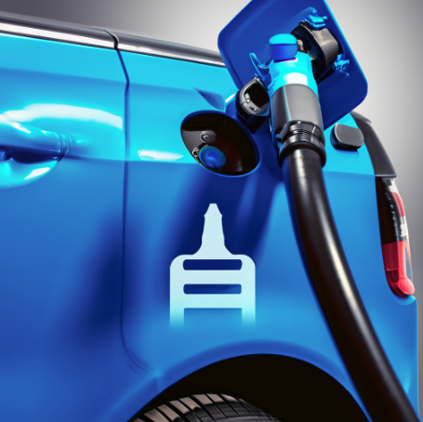
1. Zero emissions: Hydrogen fuel emit only water vapor.
2. High energy density: Enables longer driving ranges and quick refueling.
3. Versatility and renewable potential: Can be produced using renewable sources like wind and solar energy.
4. High calorific value: Compared to petrol or diesel.

Slide 11
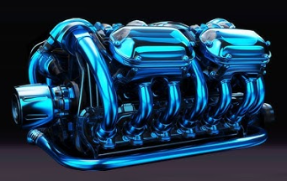
04
How The Engine Works?
The science behind the zero carbon emission engines.

Slide 12
It is a type of internal combustion engine with compression ratio ranging from 10:1 to 14:1.
It can be four stroke as well as two stroke engine depending on the required torque.
Let’s consider the case for four stroke hydrogen engine to understand the working principle.

Slide 13
Intake: Intake of hydrogen-air mixture inside the combustion chamber.
Compression: The compression of hydrogen-air mixture which increases it’s temperature as well as pressure.
Ignition: The spark plug ignites the air-fuel mixture.

Slide 14
Expansion: The blast inside the combustion chamber pushes the piston back to its BDC and that energy is used to rotate the crank shaft.
Exhaust: After the expansion is complete, the energy stored in the flywheel helps the piston to move back to its top dead centre, and while the piston moves from BDC to TDC, it pushes the burnt particles out.

Slide 15
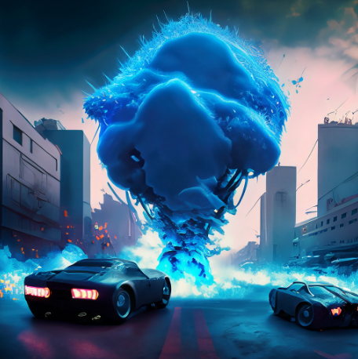
05
Hydrogen Cars! A Moving BOMB!
We will see how we are overcoming this problem.

Slide 16
Using hydrogen tank in one car is ok, but what if the city is full with hydrogen cars and their tanks? Don’t you think that hydrogen have high calorific value means its highly flammable, litres of hydrogen in multiple cars in an area can be a bomb.

Slide 17
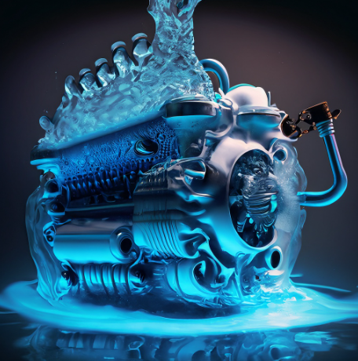
06
WATER ENGINE!
This is the idea which is known to be fake, as many low class/illiterate engineers on youtube are using logicless process just for views. But, I will prove the concept how it can be possible with the help of Science & Engineering.

Slide 18
Firstly, let’s learn how hydrogen is extracted.
We extract hydrogen from water with the help of electrolysis.
Two electrodes, annode and cathode are immersed in water.
We apply potential difference in the electrodes, water is a good conductor of electricity, but in order to increase its conductivity we mix electrolytes.

Slide 19
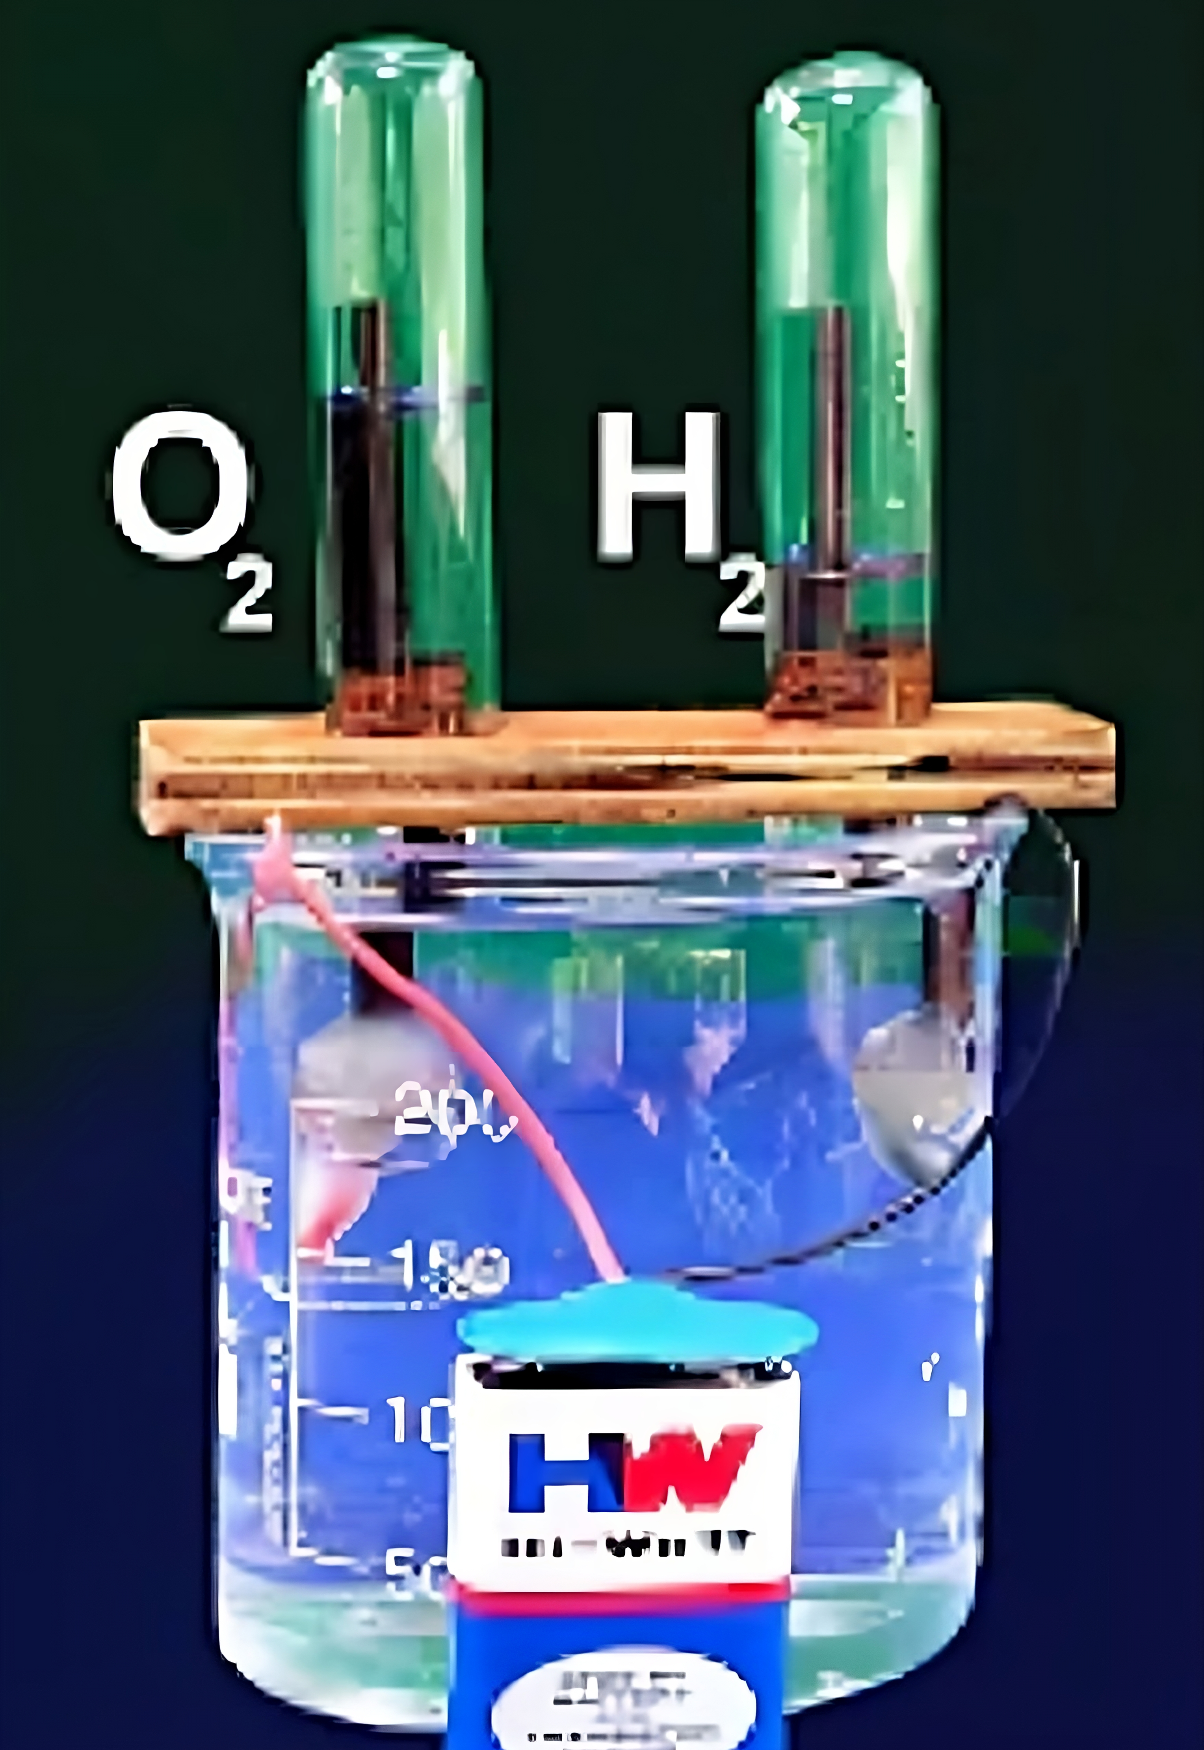
Then, hydrogen particles gets attracted towards cathode.
And, oxygen particles gets attracted towards annode.
As, big hydrogen tanks acts as a bomb, we don’t store hydrogen in its actual state, instead we store hydrogen in the form of water and we implant a hydrogen extraction plant in the car itself.
**This can be the setup by which we can extract hydrogen from water

Slide 20
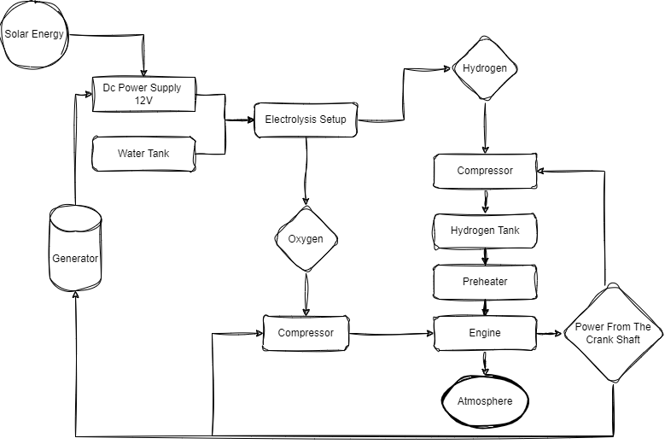

Slide 21
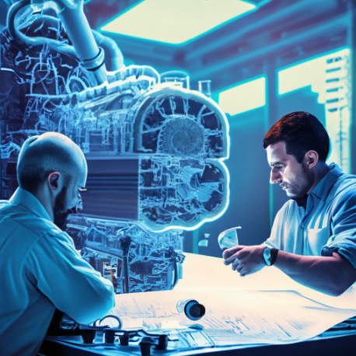
07
Why Engineers Are Not Working On These Engines?
ARE THEY STUPID? No, we will see how.

Slide 22

Big companies like Tesla, KIA, TATA etc, have created a trend of EV on this planet.
They have chosen the so called “eco friendly” subject to fool customers.
Customers think that those cars are genuinely eco friendly, as they literally can’t see fumes or carbon emission from the car, but they can’t see the amount of carbon emitted to charge their EV’s batteries.

Slide 23
As the trend of EV is at it’s peak, Engineers who are employed by those companies continue their focus on Electric Vehicles to remain in comfort zone.

Slide 24
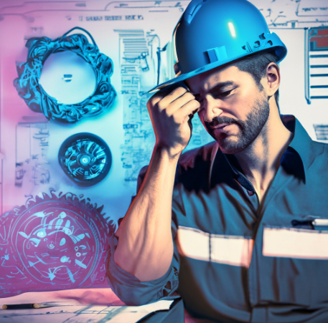
07
Disadvantages
Every man made technology do have a negative side, we will see what are the disadvantages in these Engines.

Slide 25
Water is corrosive to the metal water tank, although the water tank can be coated with water proofing or silicon from the inside to avoid corrosion.
Production cost is high.
Most of the power received from the engine is used by the compressors.
While compressing hydrogen, it is mandatory to isolate it from air/oxygen, else it would be a boom.

Slide 26

“In order to survive, our Earth shall be alive”

Slide 27
Funding Offers I Got For This Idea.
Echo Space
This idea is revolutionary, as a result, I got 1800 SAR offer from my father’s company’s HR department for making a proto type, although the payment is still under process.

Slide 28

Thanks!
Any questions?
Aquib Jawaid
Future M.D of KRATES
Jawaidaquib893@gmail.com
+91-8276961926

